Slide 1
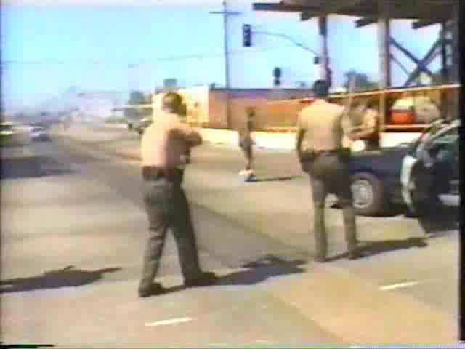
CIT- Use of Force

Slide 2
WHEN IS FORCE USED?
Protect Another
Protect Yourself
Overcome resistance to authorized control (arrest, detention or prevent escape)

Slide 3
WHO DEFINES HOW WE USE FORCE?
Standards
Guidelines
State & Federal Law
Clearly Established Case Law:
Graham v. Connor
Tennessee v. Garner
Commonwealth v. Adams
MPTC Use of Force Model
Department Policies and Procedures
Notes:
Our standards for Use of Force are derived from Case Law and Statutory Law. As we stand now, Case Law makes up the overwhelming majority of our standards. Other states, such as California have stricter Statutory Law, such as the Necessary vs Reasonable for the use of Deadly Force. We’re going to focus on three main cases: Graham v. Connor, Tennessee v. Garner and Commonwealth v. Adams.
Our guidelines on how we can use force come are derived from the MPTC Use of Force Model and your individual department’s Policies and Procedures.

Slide 4
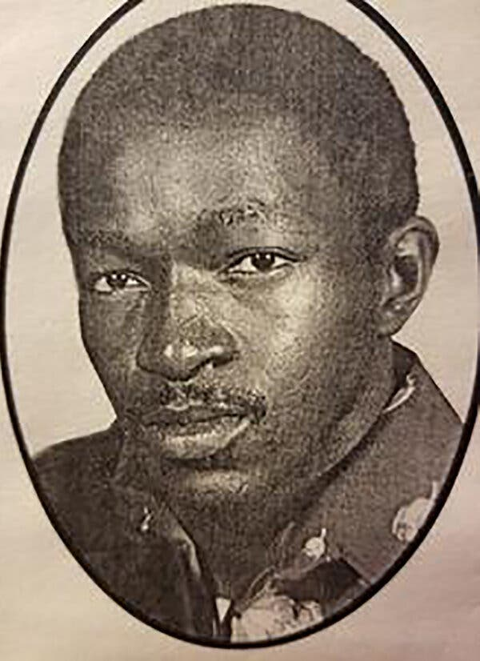
Graham v. Connor (1989)
Established that a use of force during an arrest or investigative stop is a seizure under the 4th Amendment.
The officer’s actions must be “objectively reasonable:”
in light of the facts and circumstances confronting them at the time
Dethorne Graham

Slide 5
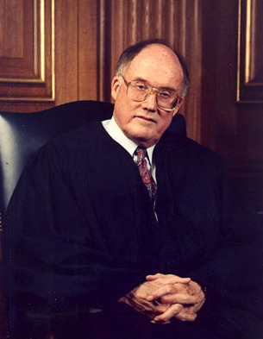
The Opinion of the Court, cont’d
“The ‘reasonableness’ of a particular use of force must be judged from the perspective of a reasonable officer on the scene, rather than with the 20/20 vision of hindsight...The calculus of reasonableness must embody allowance for the fact that police officers are often forced to make split-second judgments - in circumstances that are tense, uncertain and rapidly evolving…
Chief Justice William Rehnquist delivered the unanimous decision of the Court.

Slide 6
The Opinion of the Court –The Graham Factors
“The test of reasonableness under the 4th Amendment is not capable of a precise definition or mechanical application...Its proper application requires careful attention to the facts of each particular case, including:
the severity of the crime at issue,
whether the suspect poses an immediate threat to the officer or others and
whether or not he is actively resisting arrest or attempting to evade arrest by flight...”
Chief Justice William Rehnquist delivered the unanimous decision of the Court.

Slide 7
The Totality of the Circumstances
Courts consider the “totality” from the perspective of the “reasonable” officer on scene, including:
Why were you there
What did you know
When did you know
Why was this the best way to resolve the situation

Slide 8
Consider the Totality of the Circumstances
Many factors compose the totality of the circumstances:
Description of environment Number of officers vs. the number of subjects Any de-escalation tactics employed Officer’s size, age, and conditions vs. those of subject History of violence known at the time of the incident History in general Any psychiatric history known at the time of the incident Any evidence of drug or alcohol use Presence of bystanders and the possible threat to them Specific actions of the subject throughout the incident Subject's reactions to commands or force used

Slide 9
Consider the Totality of the Circumstances
Many factors compose the totality of the circumstances:
Duration of action – how long did it last? How you used time to your advantage (what you did relative to command, control, planning, and de-escalation attempts). Injuries to the officers or others, including medical aid provided Level of exhaustion or fatigue of the officer ** Level of resistance while being restrained The availability of weapons – obvious weapons or weapons of opportunity Whether force applied injured/affected (or not) the suspect Whether medical aid was requested by or offered to the subject
** Force Science Study 100% to 30% in?

Slide 10
SUBJECT SUSPECT
Is there a difference?

Slide 11
SUSPECT OR SUBJECT?

Slide 12
Does Graham cover medical emergencies?
A fundamental issue with applying the Graham Standard of Reasonableness to a Use of Force involving an individual suffering from a medical or mental health episode is application of the Graham 3 prong test.
Is there a higher or lower standard when the subject is a patient as opposed to a suspect?

Slide 13
Hill vs. Miracle Scotus 6th Circuit
Estate of Corey Hill vs. Miracle (6th Circuit ) (2017)
Involving medical/mental health emergencies
Argument Presented: Graham doesn’t’ apply – No crime, No resisting, No threat.

Slide 14
Hill vs. Miracle Summary of Facts
Similar to graham, Hill is a diabetic suffering from a diabetic episode
Medics respond to Hill’s residence for medical call. Hill’s blood sugar is dangerously low (38, normal range roughly 60-100).
He is combative, punched a medic, ripped IV out of arm spraying blood all over first responders.
Deputy on scene initially has no interaction with Hill, however after medic is assaulted advises Hill to relax and ultimately delivers 5 second drive stun with ECW to Hill’s thigh.
Medics are able to set the IV, deliver dextrose, stabilize Hill.
He is apologetic and remorseful for his behavior. Medics save his life.

Slide 15
Hill vs. Miracle Summary of Facts
Hill files suit under 42 USC 1983 claiming excessive force for use of ECW
Claimed ECW caused burns and scarring
Caused diabetes to worsen
Ultimately dies from complications due to diabetes
Case continues on behalf of his estate

Slide 16
Hill vs. Miracle Decision
US Court of Appeals grants qualified immunity ultimately finds Deputy’s use of ECW was reasonable
Further, SCOTUS develops new legal test for determining reasonableness in medical emergencies

Slide 17
Hill vs. Miracle Decision
In determining reasonableness in medical/mental health emergencies, the following must be considered:
Was the person experiencing a medical emergency that rendered him/her incapable of making a rational decision under circumstances that posed an immediate threat of serious harm to him/herself or others
Was some degree of force reasonably necessary to ameliorate (stop) the immediate threat?
Was force used more than reasonably necessary under the circumstances (was it excessive)?

Slide 18
Lachance v. Town of Charlton, 990 F.3d. 14 (2021)
Lachance sued officers and town for excessive force under 42 USC § 1983 and other claims
Take aways from Graham and Lachance
There are distinct differences between criminal and non-criminal uses of force
Concept of time, distance, cover and negotiations should be the initial preferred response, when appropriate
Be aware and cognizant of medical conditions
No one tool is going to act as the be all end all to resolve a situation
Officers safety is priority number 1!!!

Slide 19
555 CMR 6.00 (POST) / 550 CMR 6.00 (MPTC)
6.04: Use of Non-deadly Force
(1) A law enforcement officer shall not use force upon another person, unless de-escalation tactics have been attempted and failed or are not feasible based on the totality of the circumstances and such force is necessary and proportionate to:
(2)A law enforcement officer shall use only the amount of force necessary against an individual who is engaged in passive resistance to effect the lawful arrest or detention of said individual and shall use de-escalation tactics where feasible, including issuing a summons instead of executing an arrest where feasible.

Slide 20
555 CMR 6.00 (POST) / 550 CMR 6.00 (MPTC)
6.05: Use of Deadly Force
(1) A law enforcement officer shall not use deadly force upon a person, unless de-escalation tactics have been attempted and failed or are not feasible based on the totality of the circumstances…
(1b) The officer attempts as many de-escalation tactics that are feasible under the circumstances, including utilizing barriers where feasible
(3)An officer may not use deadly force against a person who poses only a danger to themselves

Slide 21
De-Escalation & Communication
Defined by MGL c 6E as:
Proactive actions and approaches used by an officer to stabilize a law enforcement situation so that more time, options, and resources are available to gain a person’s voluntary compliance and to reduce or eliminate the need to use force including, but not limited to verbal persuasion, warnings, slowing down the pace of an incident, waiting out a person, creating distance between the officer and a threat, requesting additional resources to resolve the incident including but not limited to calling in medical or licensed mental health professionals as defined in MGL c 111 sec 51 ½ (a) to address the potential medical or mental health crisis.

Slide 22
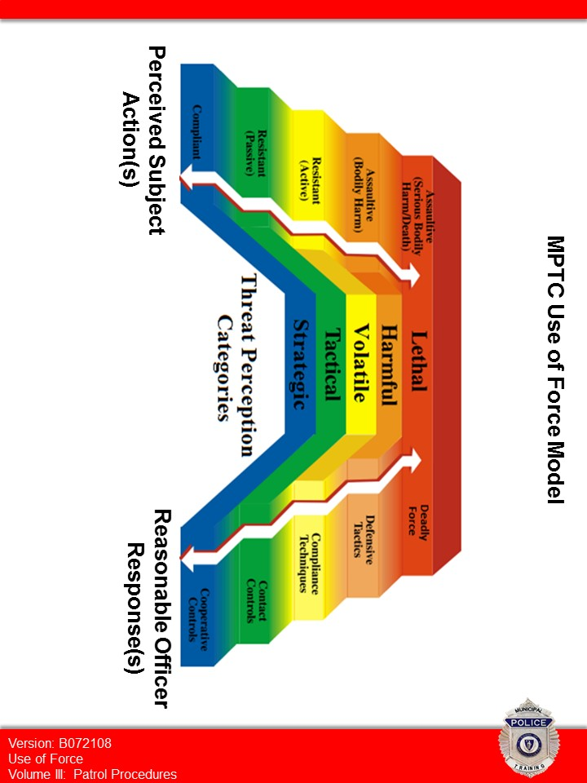
Suspect Actions Officer Response
Excessive force can occur if the officer’s response is HIGHER than reasonable.
It can be unsafe if the officer’s response is LOWER than reasonable.

Slide 23
